Slide 1

CAPSTONE PROJECT
INFLUENCER CLASSIFIER AND Q-SCORE PREDICTOR
Team Members:-
Aditya Rai
Rajdeep Chakravorty
Shrikant Panigrahi
Sachin Kshirsagar

Slide 2


Slide 3
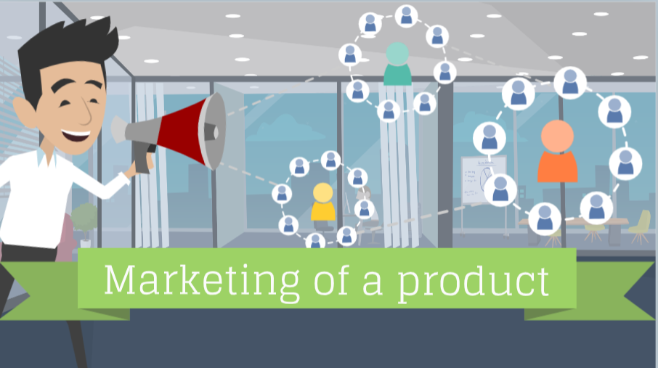

Slide 4
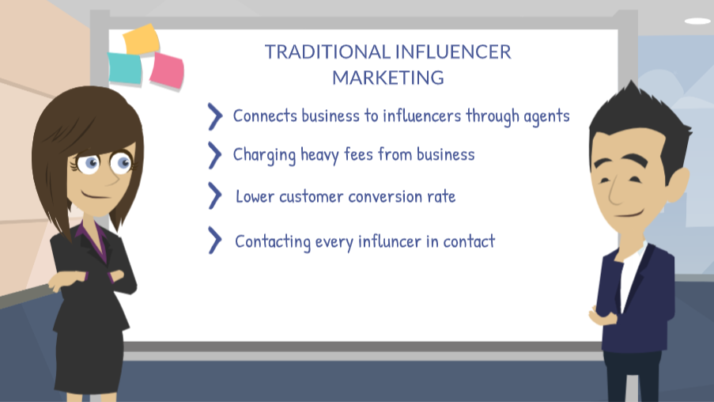

Slide 5
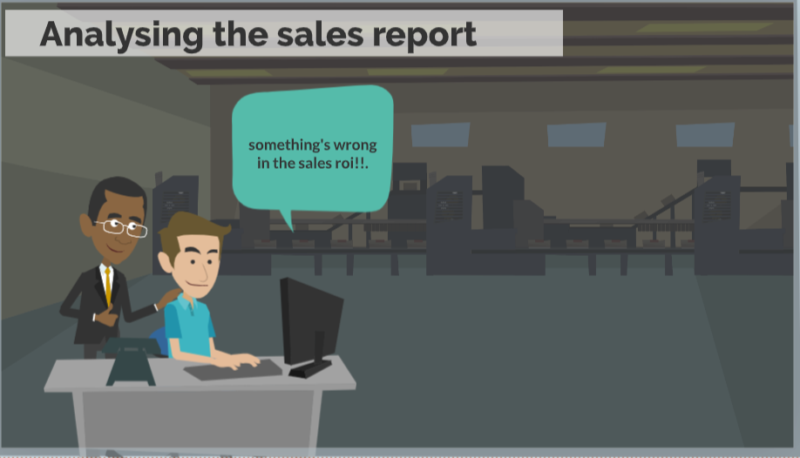






Slide 6

SMALL STARTUP.CO

Slide 7
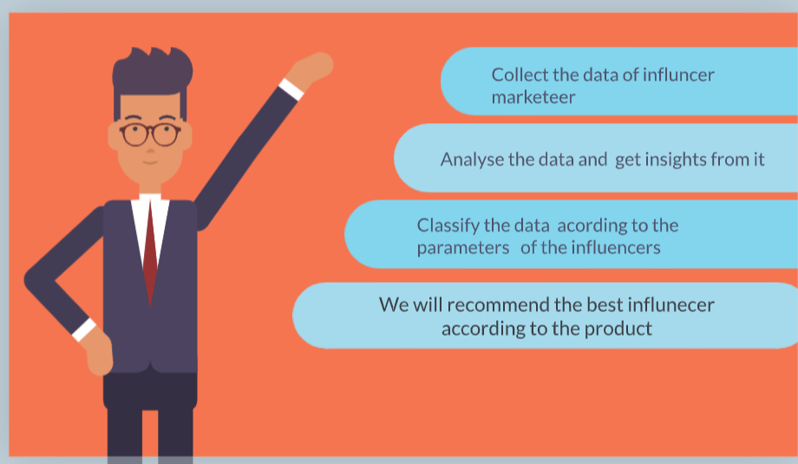

Slide 8
What is Q-Score
The Q-Score is a metric used to evaluate the performance and influence of an individual or brand, particularly in the field of marketing and advertising. It provides insights into an influencer's effectiveness in engaging their audience and driving desired outcomes.
The Q-Score takes into account various factors such as reach, engagement, and relevance. It measures the level of recognition and appeal an influencer has among their target audience. Higher Q-Scores typically indicate a stronger impact and influence.

Slide 9











User
Dataset of Influencers
Influencer Classification a/c tier
Workflow
Check popularity (Q-Score)
Influencer Selection

Slide 10
Brands we are working with.
Bake your Cake ( food).
Bend the trend (fashion).
Ipsumteq (Branding and advertising ).
Green Apple Computer (gaming setup and accessories).

Slide 11
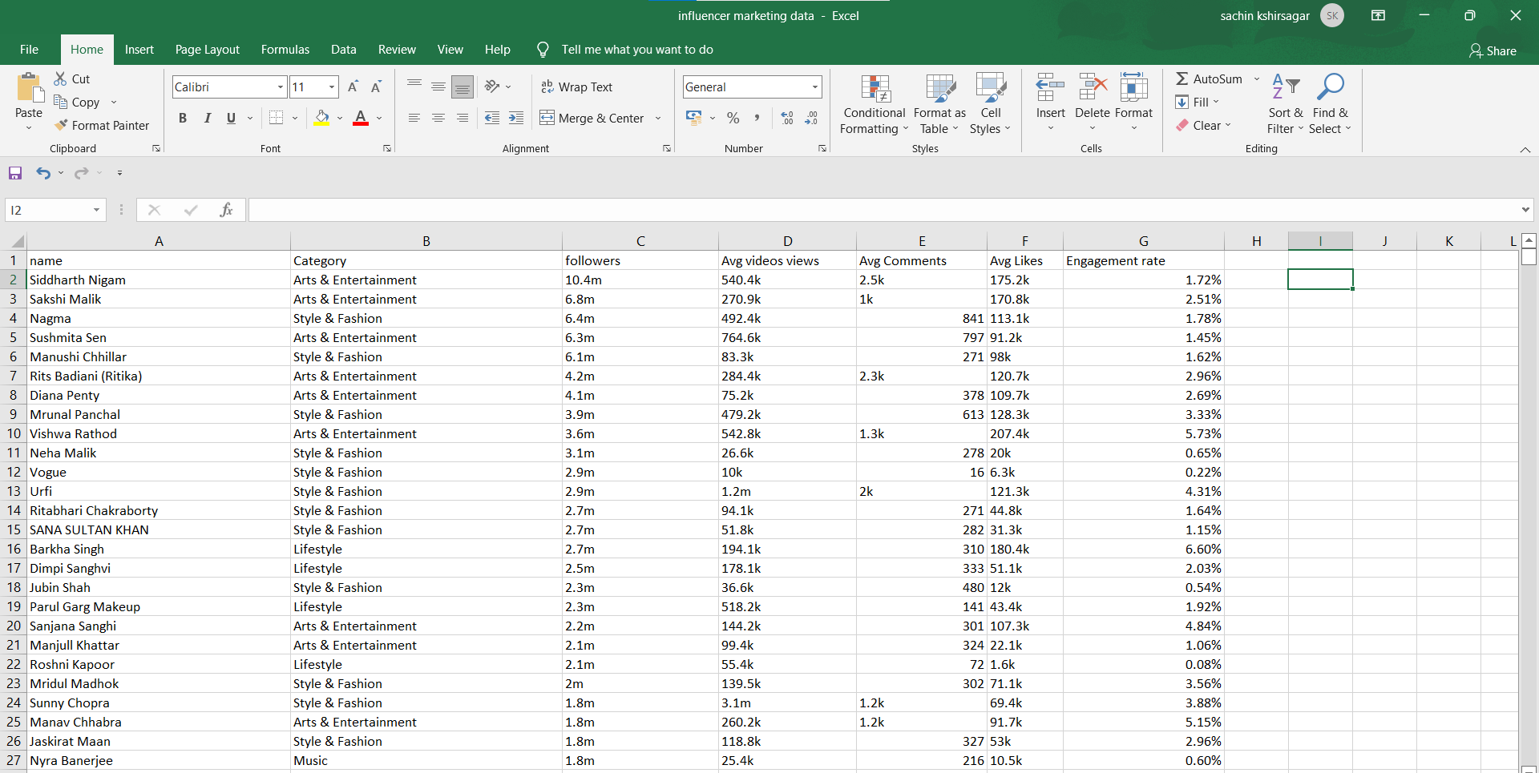
Initial Scrapped Data

Slide 12
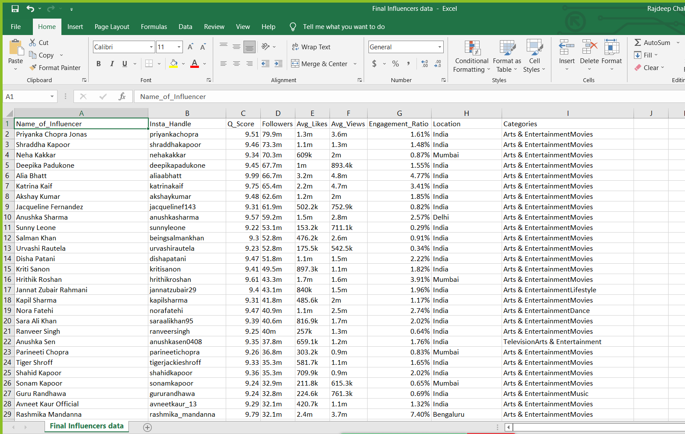
Re-Scrapped Data

Slide 13

Task List
Re-Scrapping the data
Re-scrapped the data as the previous data was messy data
Handling the symbolic & categorical values
Handled(cleaned) the “%” and “k” ,”m” values from the numerical values
Merging the categories
As there were many categories we tried to merge them into 14 categories
Creating new column (Influencer_Tier)
Created new column for the data to classify tier based on followers
Handling missing values of two columns
Handled the missing value of avg_like and avg_views based on tier ratio

Slide 14
Task List
Dropping the unwanted data
Dropped the values which were null in both the column.
Model Building
(Regression)
Predicted the Q-Score
Model Building (Classification )
. Build a model on created data

Slide 15
DATA PREPROCESSING
Handling the symbolic value in numerical for column Engagement Ratio (% replaced by blank)
Cleaning the Alphabetic letters into Numerical (m -> millions, k-> thousands)
Followers
Avg_likes
Avg_Views

Slide 16
Analyzing the categories and grouping them into similar categories to reduce the number of categories. (Done in Excel itself -> Filter -> Find & Replace)
Step includes Finding the similar categories and mapping them into similar types of categories.
We had 214 categories initially after mapping it reduced to merely 14 categories.

Slide 17
Creating a column based on No of Followers. (Influencer_Tier)
When followers were between 20000 and 100000:
Influencer Tier was set as "Micro“
When followers were between 100000 and 500000:
Influencer Tier was set as "Mid Tier“
When followers were between 500000 and 5000000:
Influencer Tier was set as "Mega“
When followers greater than 50000000
Influencer Tier was set as “Celebrity“

Slide 18
Handling the Null Values (Avg_Likes)
We Analysed the data and found out that there is some sort of relation between Avg_Likes and Avg_Views on the basis of that we imputed the missing values according to Influencer_Tier
Then we used the ratio method to find out the percentage of different Influencer_Tiers
Handling the Null Values (Avg_Views)
We handled the Avg_Views, in a same way we did for Avg_Likes
just by reversing the approach.

Slide 19
After imputing the missing values of Avg_Views and Avg _likes, we found a few missing values.
Thus after analyzing the data we found that these set of missing values were noninfluential to our final result.
So we decided to drop those rows.
After this our data is ready for modeling purposes.

Slide 20
MODELLING
INFLUENCER CLASSIFIER
Used classification models such as DT classifier, RF classifier
Q-SCORE PREDICTOR
Used regression models such as RF regressor, DT regressor

Slide 21
DEPLOYMENT
Used Streamlit Framework
We utilized the Streamlit framework to create and deploy our application. Streamlit is a popular Python library used for building interactive web applications with a focus on data science and machine learning. With Streamlit, we were able to create a user-friendly interface for our app, allowing users to interact with and explore our project or data.

Slide 22
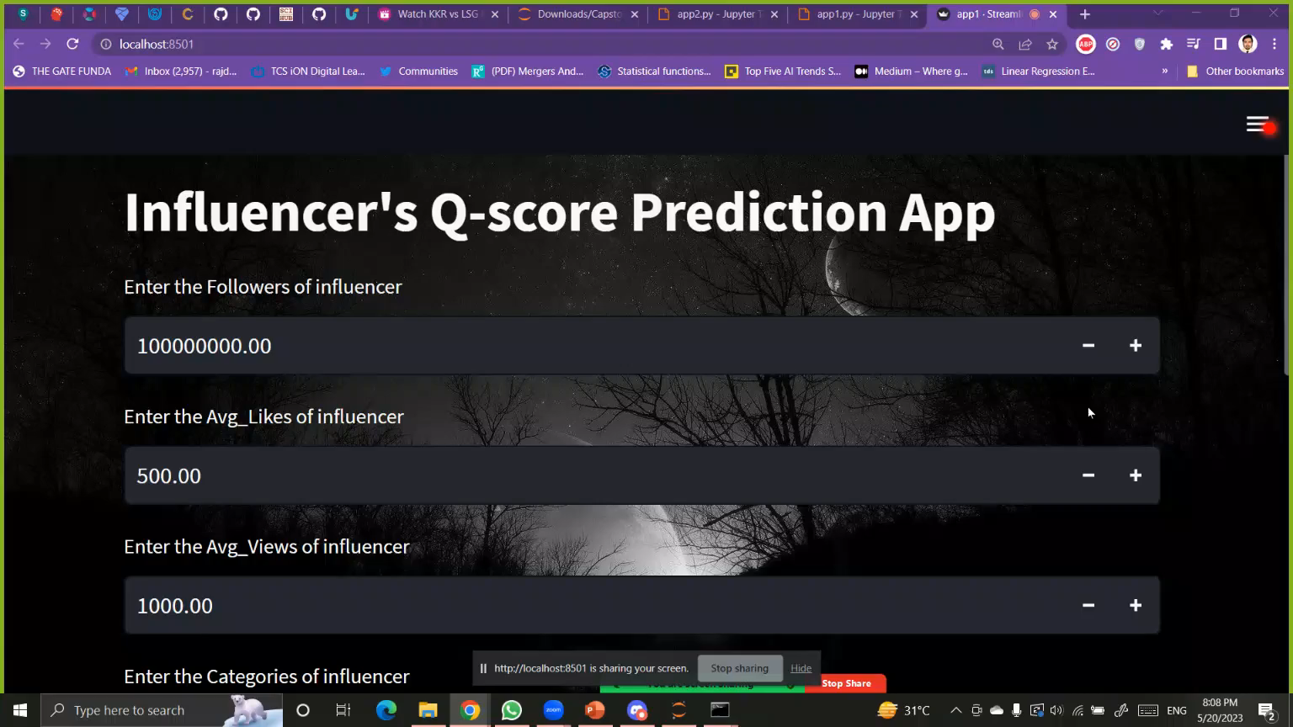

Slide 23
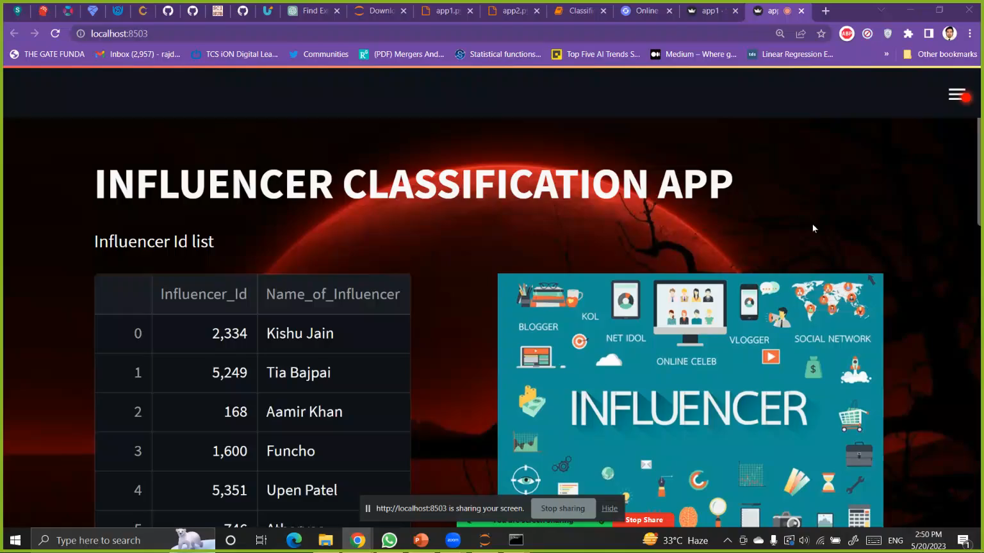

Slide 24


